Slide 1

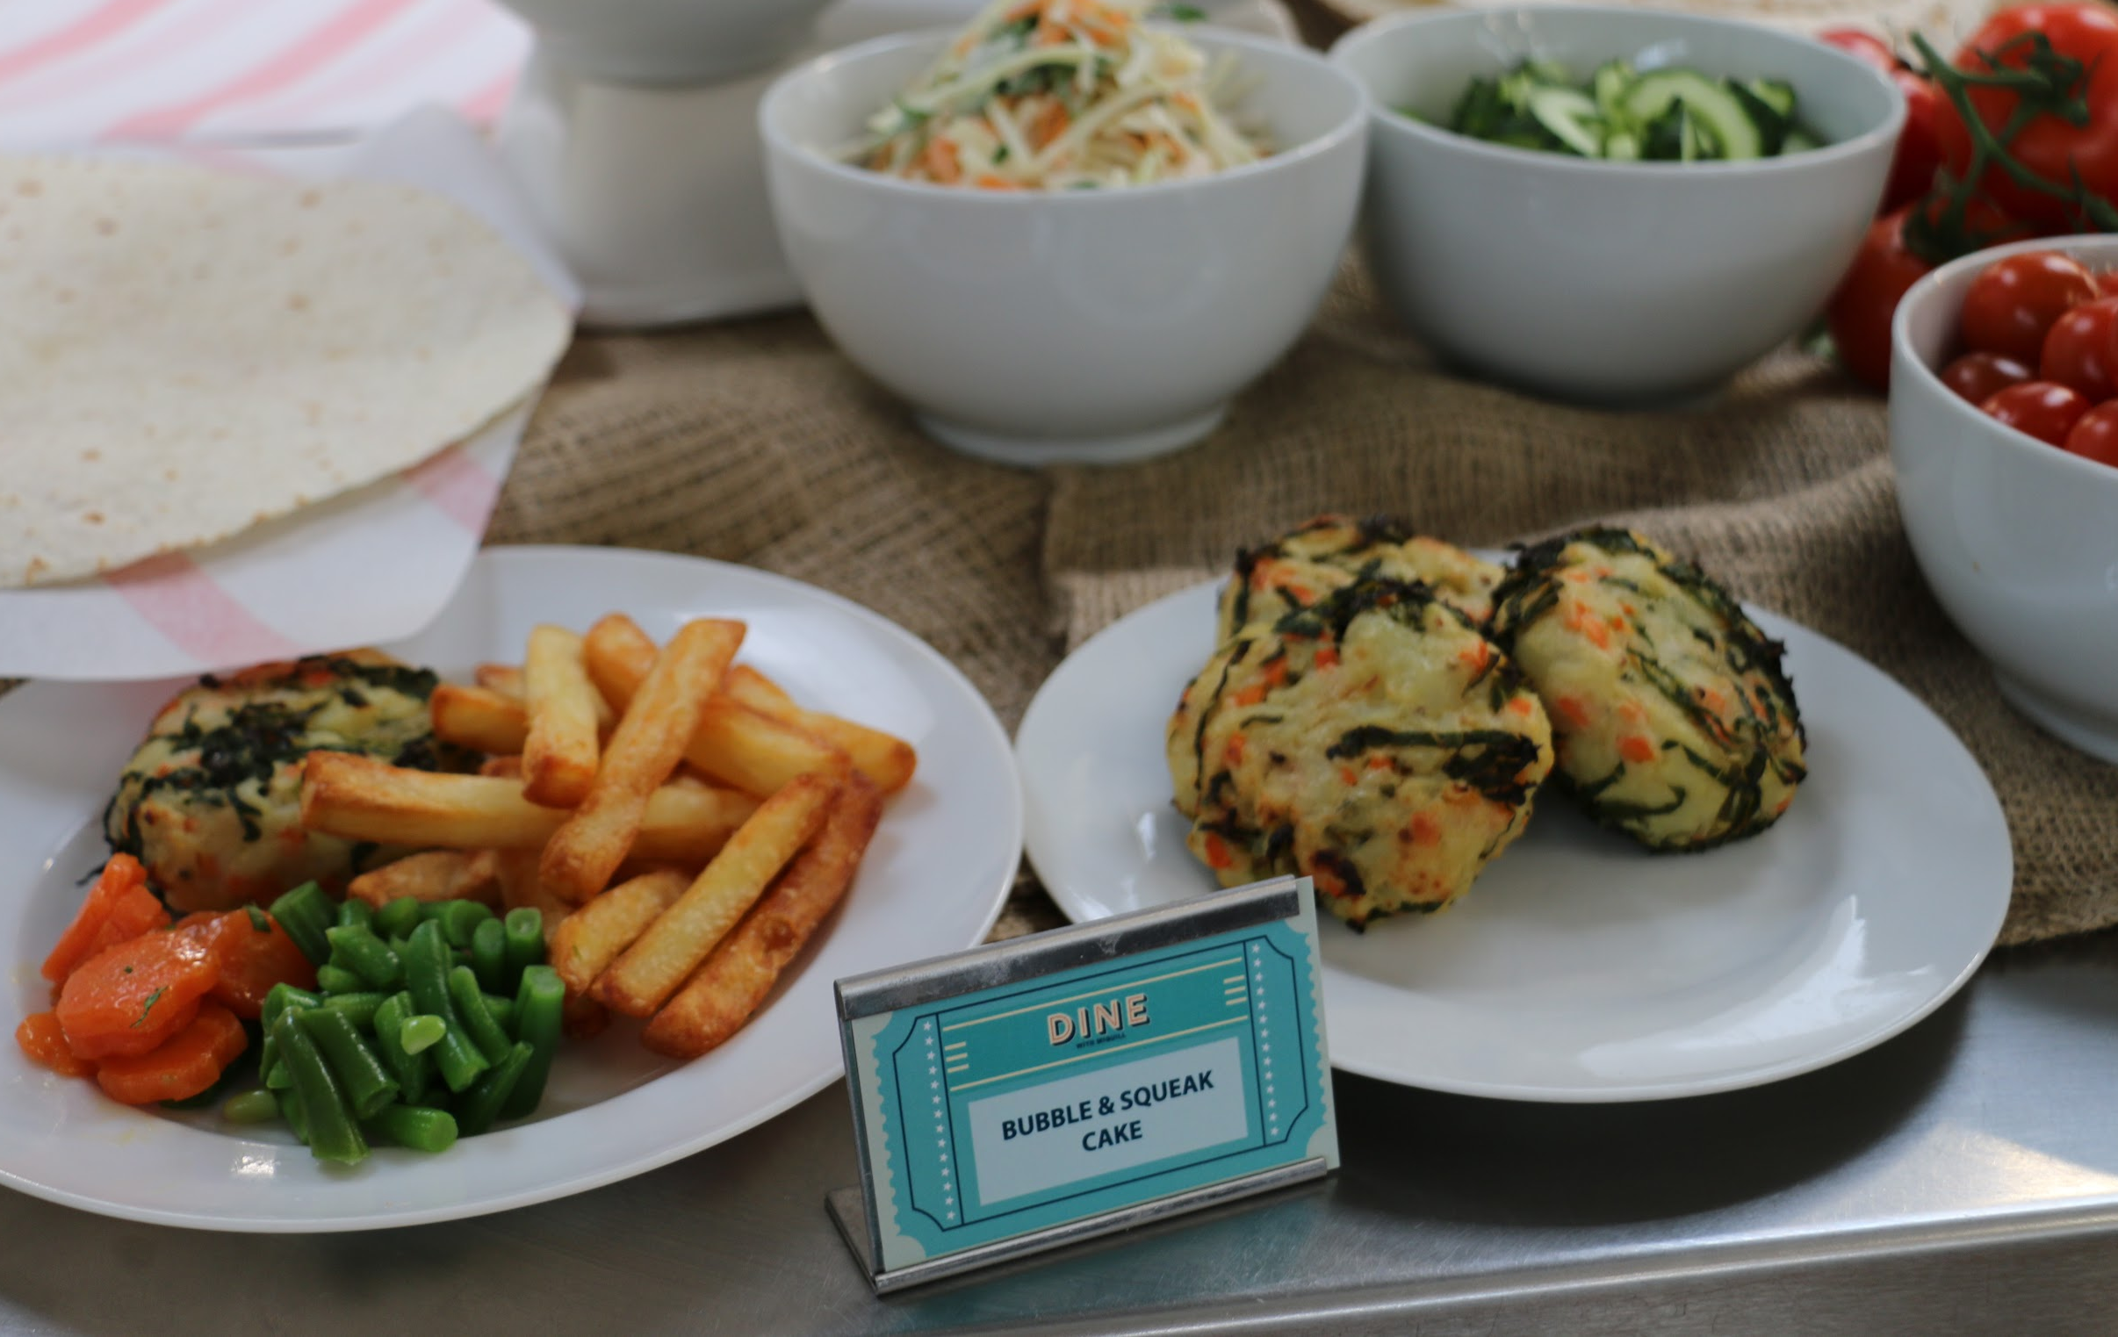
Welcome to Our Termly Newsletter!
We’re excited to bring you our latest updates about the meals at your School and share what’s coming up in the near future. We hope you find this information helpful and enjoy learning more about our school meals. Happy reading!
On the following pages you will find copies of our current menu:
ALLERGIES AND DIETARY NEEDS
We hope that your child is enjoying our new school menu which continues until October! We invested a great deal of time in producing the menu, and took insights from the high street and popular brands when compiling it. As a result, we have created a range of tasty, nutritious meals that the children love. Look out for both new and classic dishes as well as old favourites such as Chicken Tikka Masala and our ever-popular Beef Lasagne.
We hope the students at Alcester Academy enjoy our food, and we encourage everyone to give something new a try!
Important information on how the school caters to children with food allergies or special dietary needs.
Your child’s health and safety are our top priorities, and we take allergies and dietary needs very seriously. If your child has any specific requirements - whether it’s an allergy, intolerance, or cultural dietary preference - please let us know so we can ensure they have safe and suitable meal options.
We work closely with parents and students to make sure everyone has access to meals that are both delicious and safe to eat.
Notes:
Select File and Make a Copy and save to your preferred area. This will be the document that you then edit and personalise to your school. Delete all of the yellow highlighted parts and yellow boxes! HELP TO COMPLETE IN THIS GUIDE - https://docs.google.com/presentation/d/1fRwdih57RII9-wZfnLTuwT3G44ODo7GjXmCeFAOHn0Y/edit?usp=sharing

Slide 2

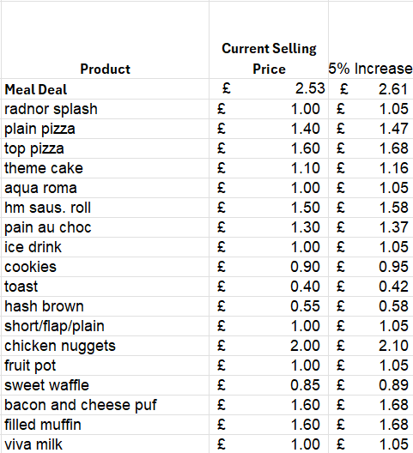

Important update- Meal pricing
We would like to make parents aware that unfortunately we will be increasing our prices with effect from September 1st, 2025. This is due to several rising cost pressures over the last 12 months that are outside of our control, namely:
6.7% national minimum wage increases
1.2% National Insurance increases, further impacted by a £4,100 reduction in employers NI contribution threshold.
3.6 % food inflation rises (July 2025), predicted to rise to 5.1% by September 2025
https://laca.co.uk/news/igd-predicts-food-inflation-peak-51-2025
The overall impact to our operational costs has risen by 11.5% in the last six months, and we have worked hard to reduce the pass on costs for our meals to a 5% increase across all lines.
We appreciate that the cost of living crisis is of grave concern and will continue to provide balanced, value for money dishes to all students within Alcester Academy. An overview of some of the key affected lines is as follows:
0800 043 6604 | www.miquillcatering.co.uk | info@miquillcatering.co.uk

Slide 3

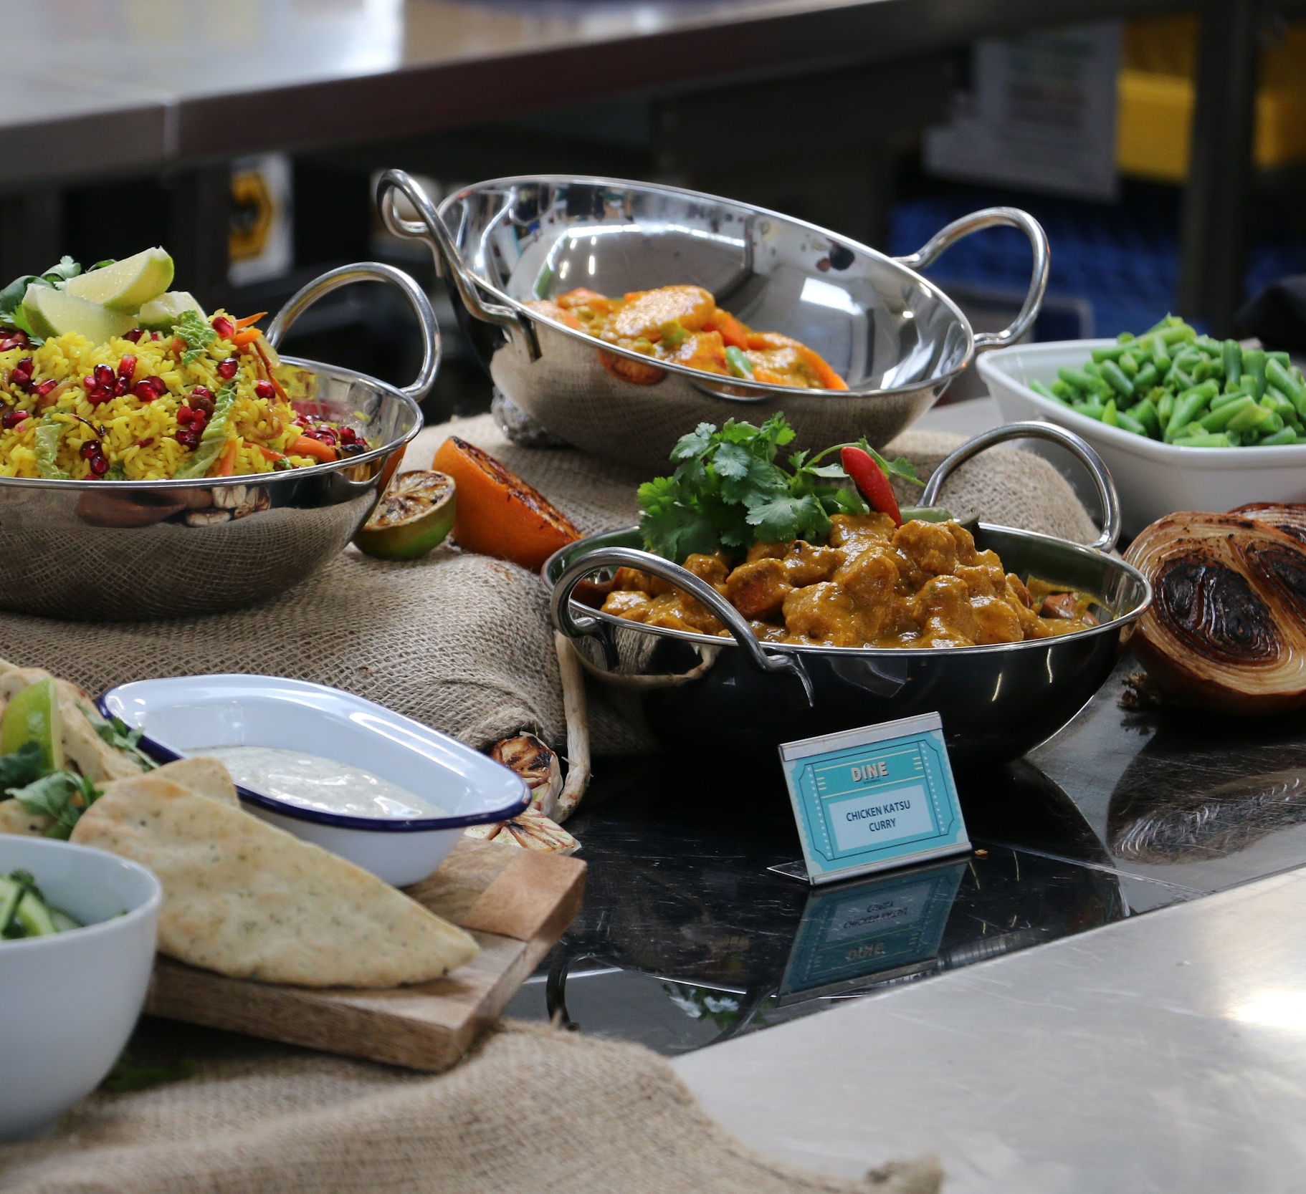
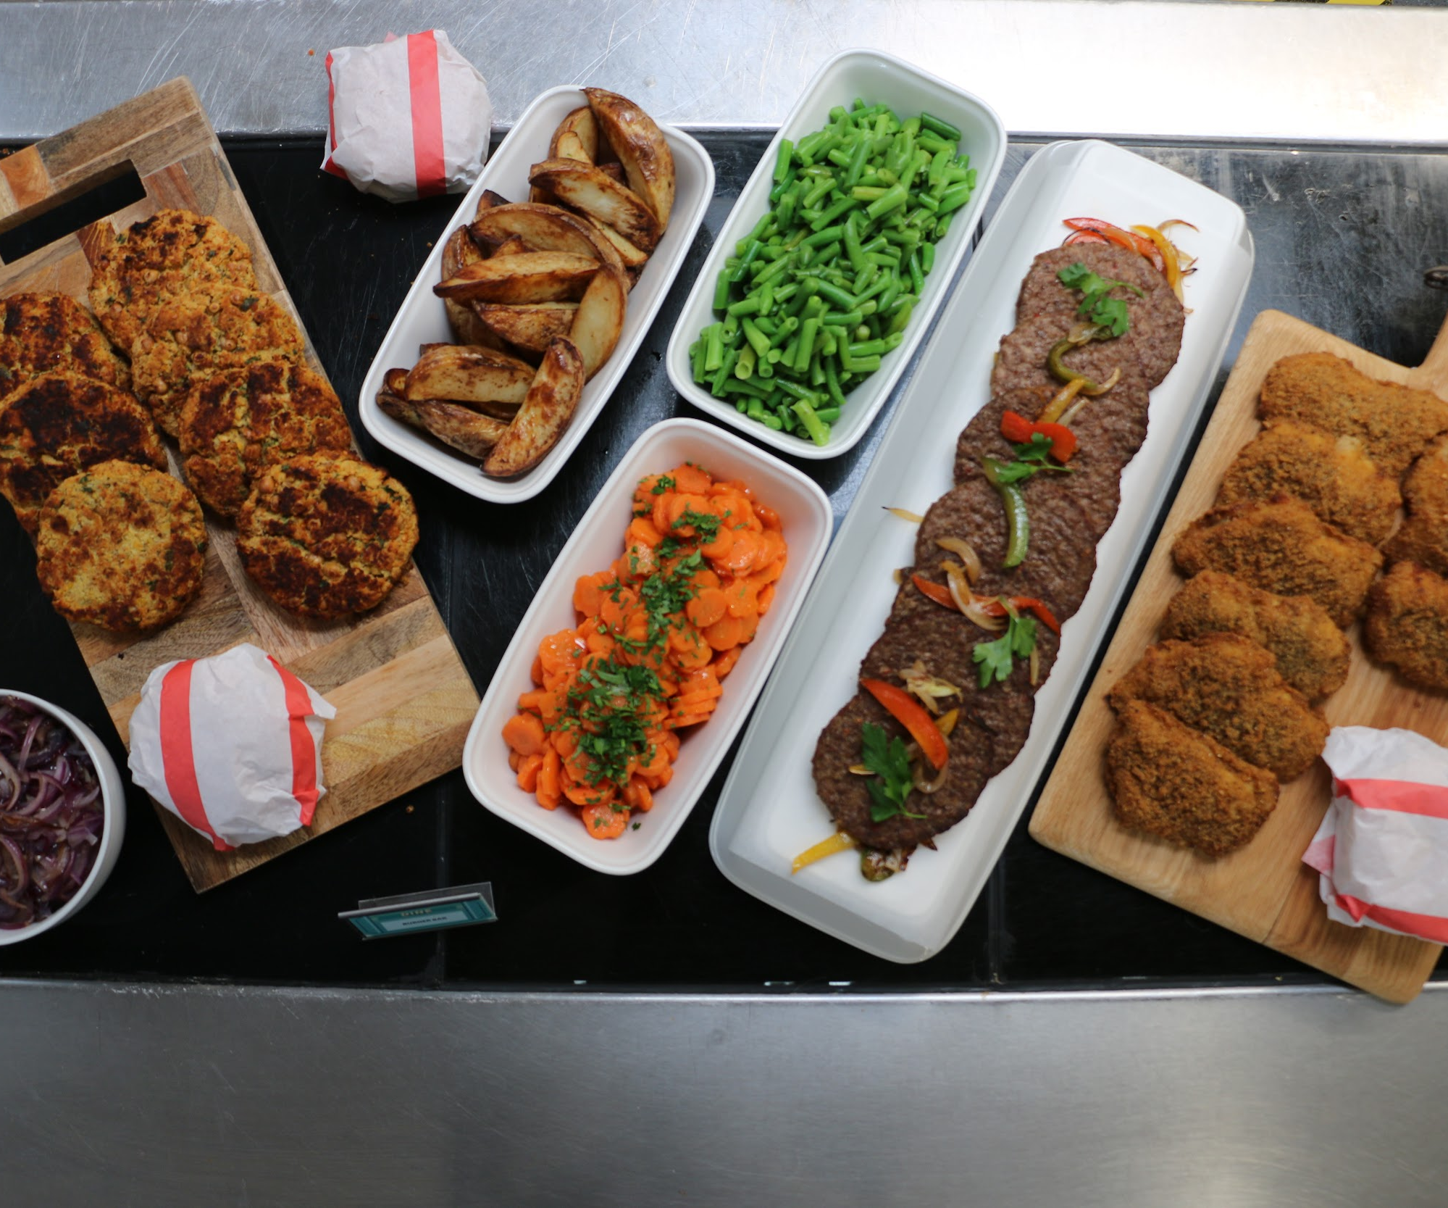
FREE SCHOOL MEALS – IS YOUR CHILD ELIGIBLE?
Some families may be eligible for free school meals. If you’re receiving certain benefits or meet specific financial criteria.
It’s easy to check – just visit www.gov.uk/apply-free-school-meals to find out more and see if you qualify.
We’re here to make sure every child has access to a nutritious, tasty meal, so if you have any questions, feel free to get in touch!
Get involved - we value your feedback
We’re always looking for ways to improve and make school lunches even better. Whether you have suggestions, feedback, or questions, we’d love to hear from you. Feel free to reach out to our team via our Operations Manager, Sadie Hollway Sadie.hollway@miquillcatering.co.uk
We are also planning on introducing termly student surveys and student forum meetings in the new academic year, which we hope will help us to improve our offer further.
Thank you for supporting our mission to provide every child with a nutritious and enjoyable lunch!
Why choose a school lunch?
We believe lunchtime is a crucial part of the school day. It’s a time for students to refuel, relax with friends and get ready for the afternoon. Our school lunches are designed to be balanced and nutritious, helping your children stay full, focused, and happy.
We’re dedicated to providing meals that are not only tasty but also introduce kids to new flavours and cuisines. From classic British dishes to exciting new options, we want every lunchtime to be both delicious and a fun learning experience.
Encourage your child to try school lunches - we take pride in creating meals that kids really enjoy!
Notes:
Delete all of the yellow highlighted parts and yellow boxes! HELP TO COMPLETE IN THIS GUIDE - https://docs.google.com/presentation/d/1fRwdih57RII9-wZfnLTuwT3G44ODo7GjXmCeFAOHn0Y/edit?usp=sharing

